Slide 1
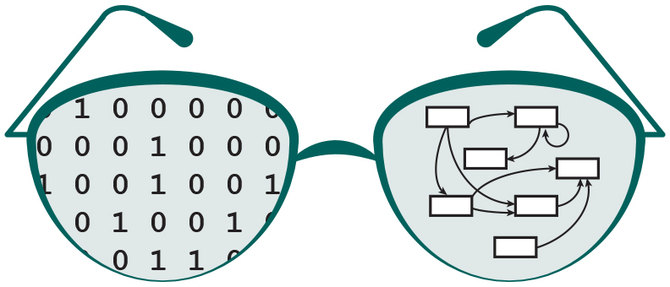
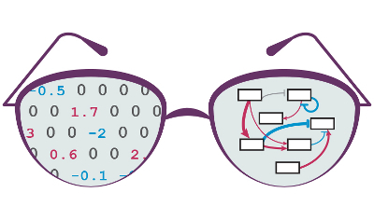

Design and Layout Improvement to GRNsight v2.0: a Web Application and Service for Visualizing Small- to Medium-Scale Gene Regulatory Networks
Nicole Anguiano and Anindita Varshneya
Department of Biology
Department of Electrical Engineering and Computer Science
Loyola Marymount University
LMU Undergraduate Research Symposium
March 25, 2017
Notes:
anu

Slide 2
Outline
Gene regulatory networks (GRNs) consist of genes, transcription factors, and the regulatory relationships between them.
GRNsight is an open source web application and service for visualizing models of gene regulatory networks.
Version 1.0 established a testing framework created an errors and warnings library.
Version 2.0 is in active development, available in beta website, and will allow for greater customization of the graph visuals.
Notes:
anu

Slide 3
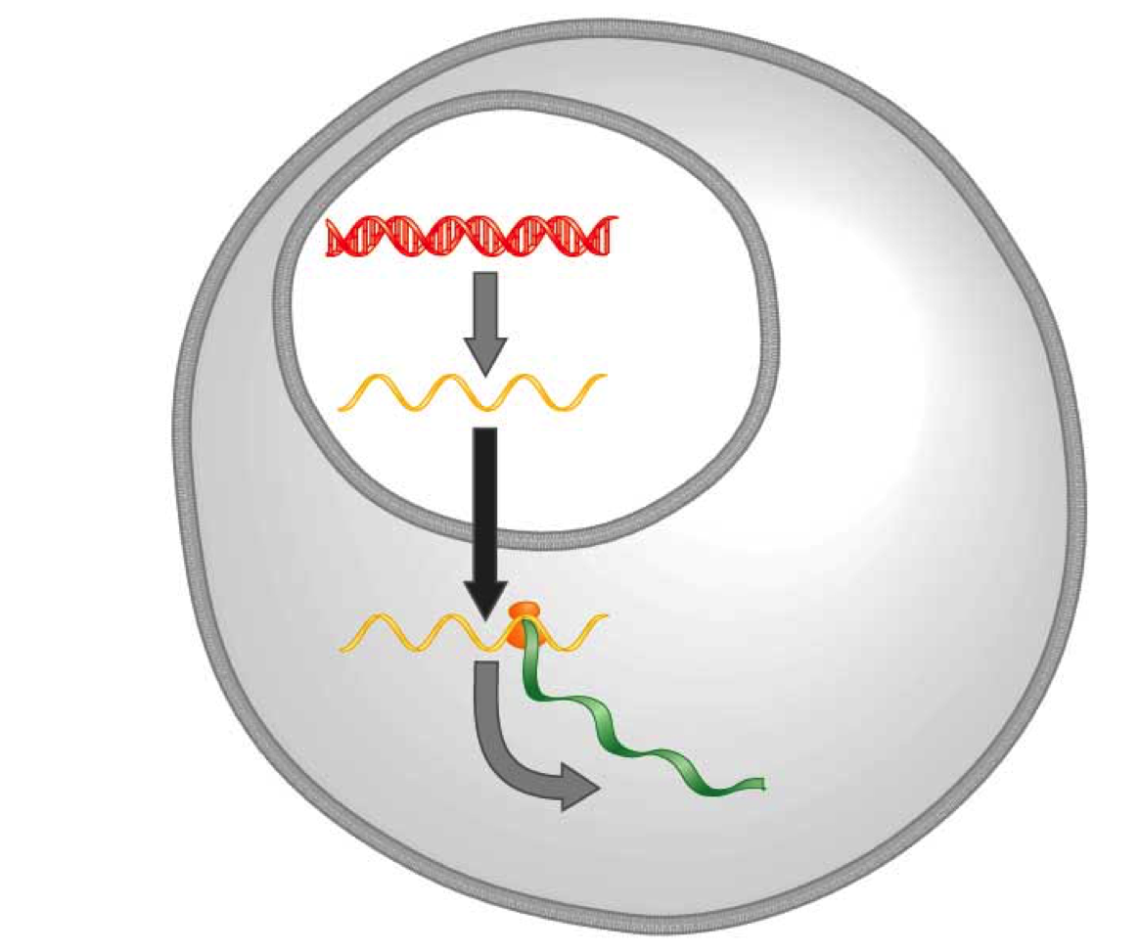
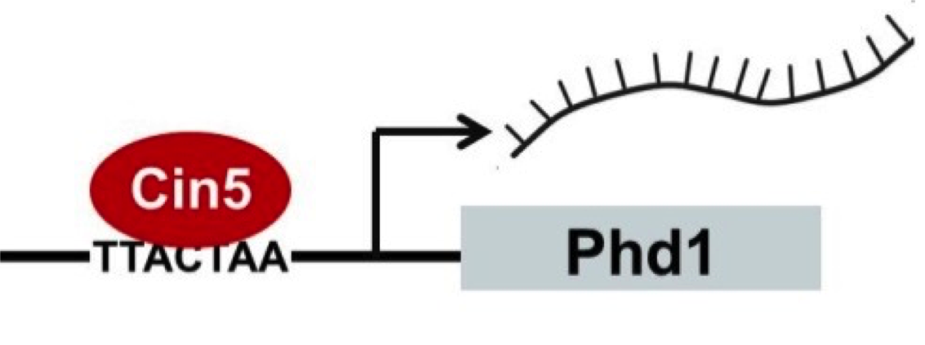
Transcription Factors Control Gene Expression By Binding to Regulatory DNA Sequences
Activators increase gene expression
Repressors decrease gene expression
Gene regulatory networks govern the level of expression of mRNA and proteins from those genes.
DNA
Transcription
mRNA
Translation
Protein
Notes:
Anu
Not the right information, use combinatorial control diagram which shows combinations of transcription factors which might

Slide 4
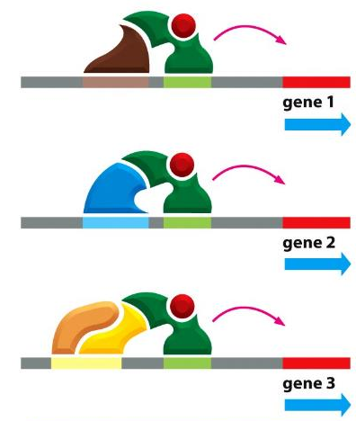
In Yeast, ~250 Transcription Factors Regulate the ~6000 Genes through Combinatorial Control
Alberts et al. (2014)

Slide 5
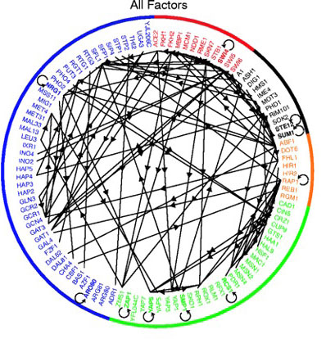
In Yeast, ~250 Transcription Factors Regulate the ~6000 Genes through Combinatorial Control
Gene Regulatory Network (GRN)
of 106 Transcription Factors
Alberts et al. (2014)
Lee et al. (2002)

Slide 6
GRNsight is Optimized to Visualize Small- to Medium-Scale Networks
Programs such as Cytoscape and Gephi visualize gene regulatory networks, but are optimized for large-scale graphs.
These programs need to be installed onto computers.
Both programs are complex and have several features in addition to visualization.
GRNsight is user friendly, exists as a web application, and lays out network graphs for medium-scale GRNs that are easily interpretable.

Slide 7
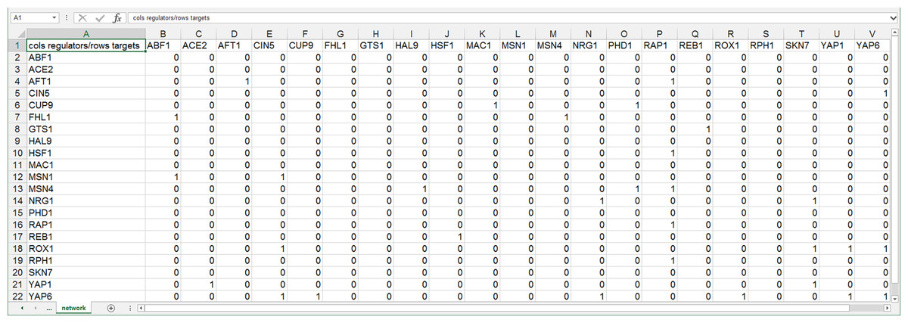
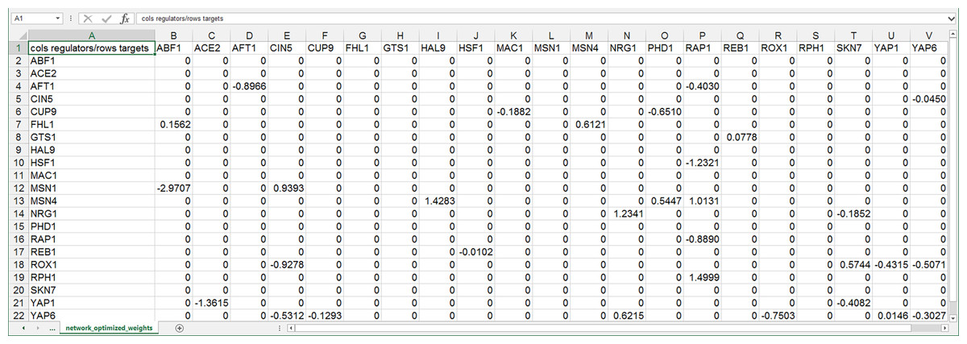
GRNsight Accepts Excel Spreadsheets with an Adjacency Matrix
Regulators and targets are in columns and rows respectively
Unweighted networks have 1’s and 0’s, weighted networks have real numbers instead of 1’s
Positive numbers indicate activation and negative numbers indicate repression
unweighted
weighted
Dahlquist et al. (2016) PeerJ Computer Science
Notes:
Anu
All are directed, but only some are weighted.

Slide 8
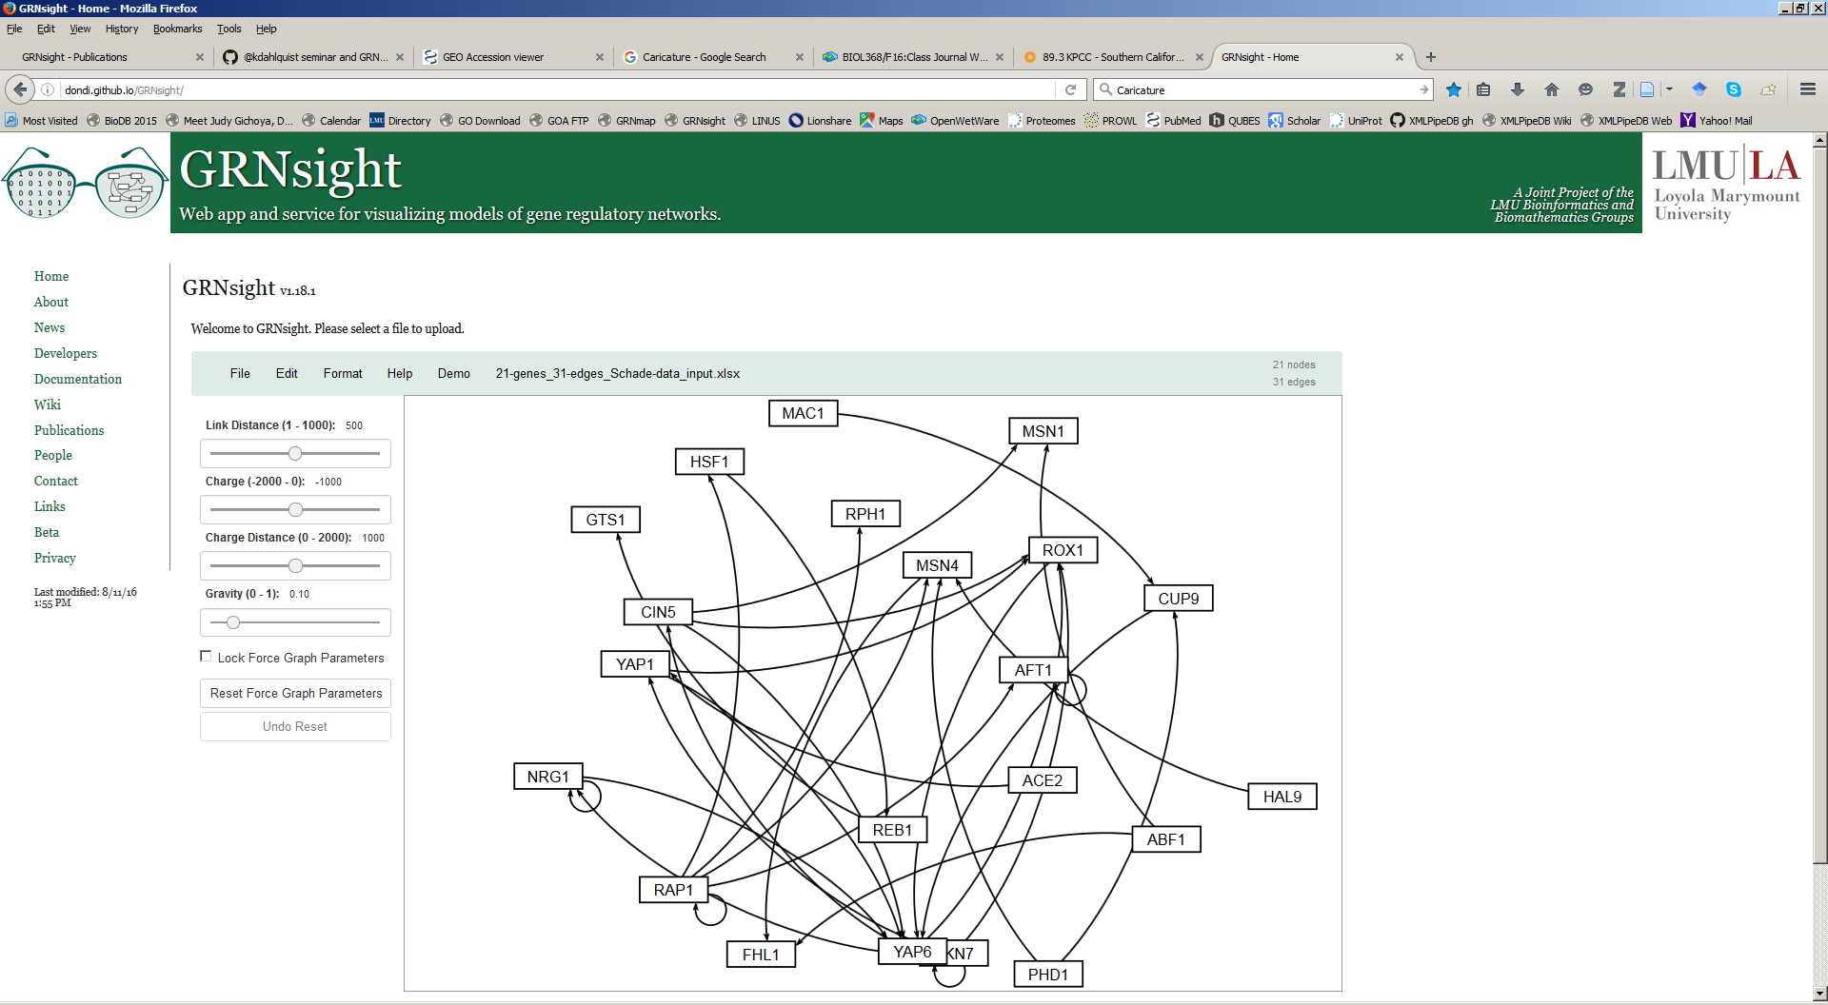
GRNsight Rapidly Generates GRN Graphs Using Our Customizations to the Open Source D3 Library
10 milliseconds to generate
Dahlquist et al. (2016) PeerJ Computer Science

Slide 9
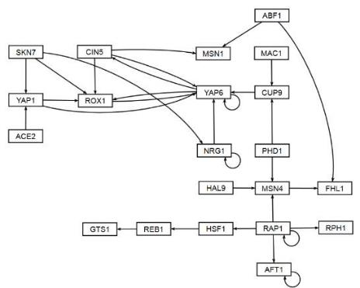
GRNsight Rapidly Generates GRN Graphs Using Our Customizations to the Open Source D3 Library
10 milliseconds to generate, 5 minutes to arrange
Dahlquist et al. (2016) PeerJ Computer Science

Slide 10
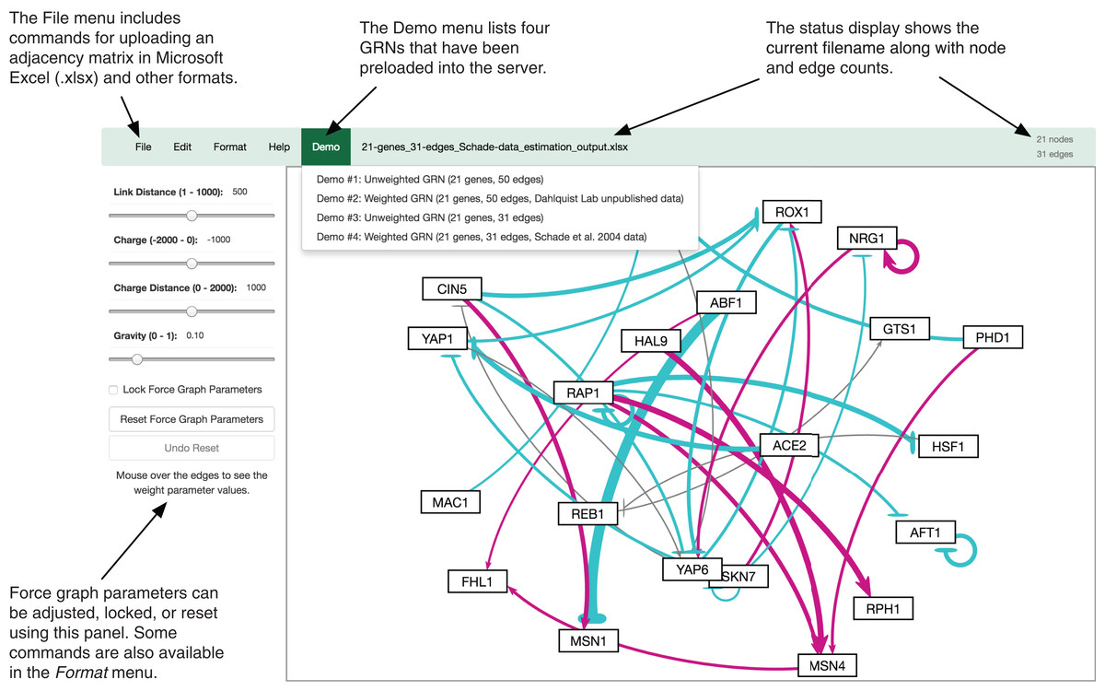
GRNsight Automatically Lays Out Weighted and Unweighted Networks
Dahlquist et al. (2016) PeerJ Computer Science
Notes:
nicole

Slide 11
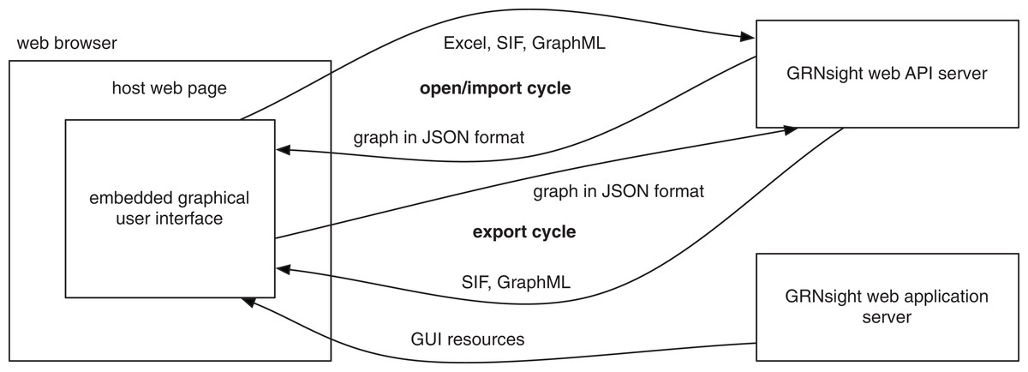
GRNsight Has a Service-Oriented Architecture
Dahlquist et al. (2016) PeerJ Computer Science
Notes:
nicole

Slide 12
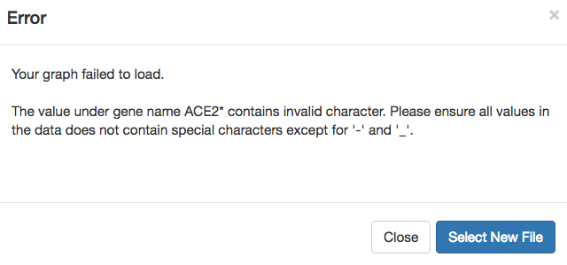
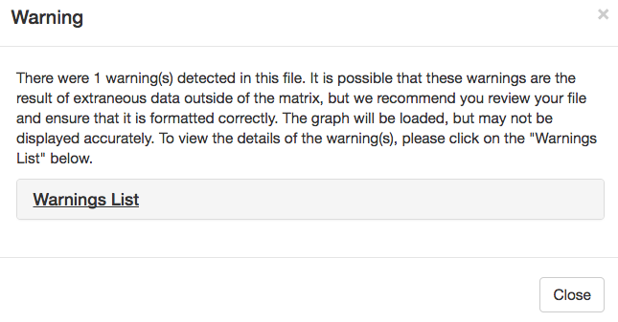
The Errors and Warnings Library Was Established In v1.0
When a user uploads a spreadsheet that is formatted incorrectly – GRNsight returns an error or a warning
Fatal = graph fails to load
Non-fatal = graph will load
Warning box can be closed and reopened at any time via a hyperlink underneath Force Graph Parameter sliders
Notes:
anu

Slide 13
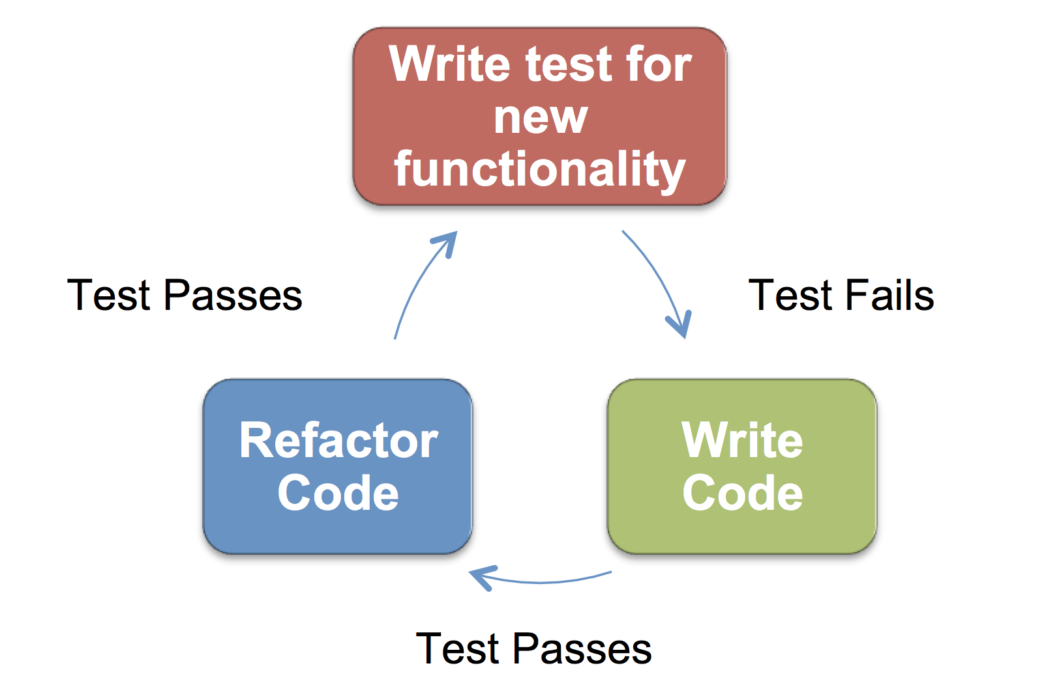
Test Driven Development (TDD) Ensures GRNsight Works as Expected
Consists of 161 passing tests covering over 500 test files in beta
Executed through Mocha, a JavaScript test framework running on node.js and written in Chai, an assertion library for node.js
Aspect of the code | Test coverage on v1.18.1 (%) | Test coverage on v2.0.1 (%)
Statements | 272/371 (73.32) | 344/489 (71.67)
Branches | 158/185 (85.41) | 169/203 (83.25)
Functions | 49/72 (68.06) | 61/96 (63.54)
Lines | 272/371 (73.32) | 344/480 (71.67)
Notes:
anu

Slide 14
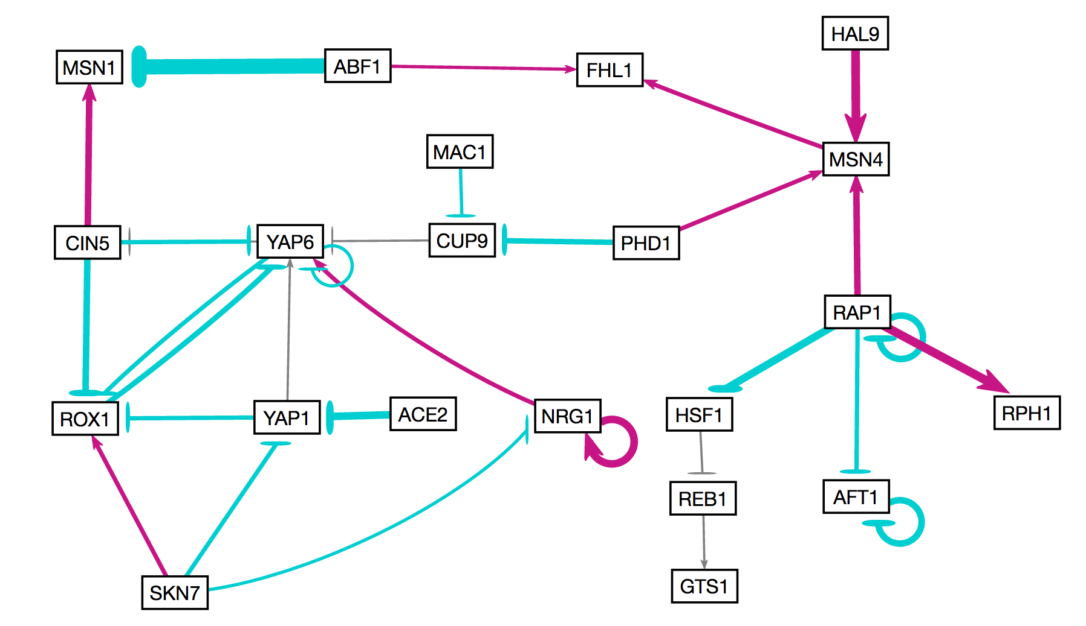
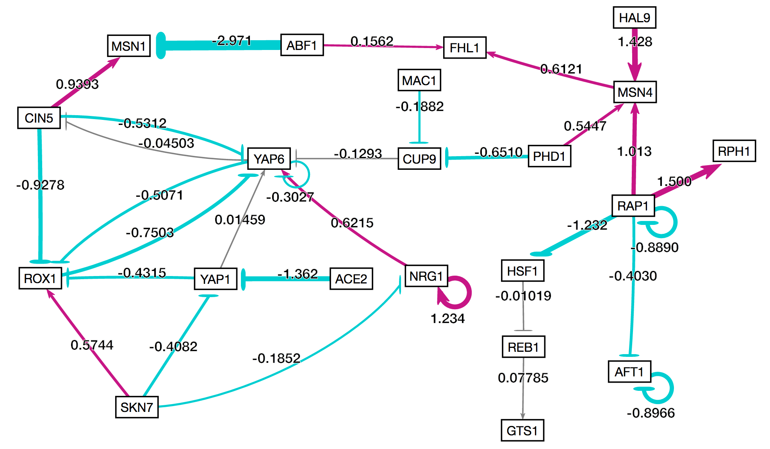
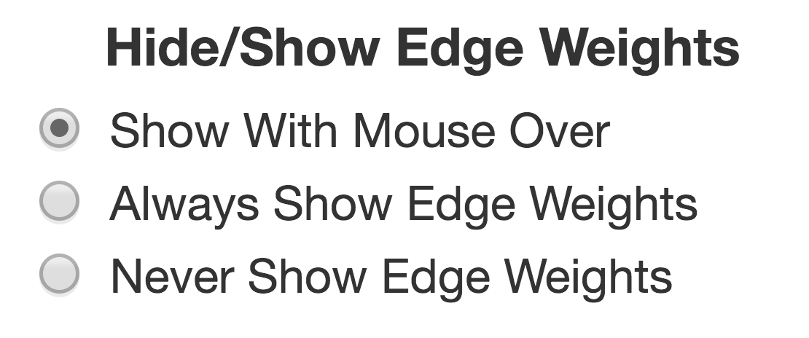
Visualization of Edge Weights is User Customizable
By default, weights are shown only upon mouse-over of the edge.
Users can choose to always show or always hide weights.
Option exists in sidebar menu, and under Format tab in the File menu.
Notes:
anu

Slide 15
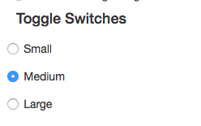
The viewport was enlarged to allow for easier visualization on different screen sizes
Three different viewport (visible area) sizes were added to adjust for different screen sizes.
Small is best for 13-15” laptops
Medium is best for 24” screens
Large is best for 32”+ screens
The initial size of the viewport is chosen automatically based on the amount of available space on the user’s screen.
It can also be changed via toggle switch.
Notes:
nicole

Slide 16
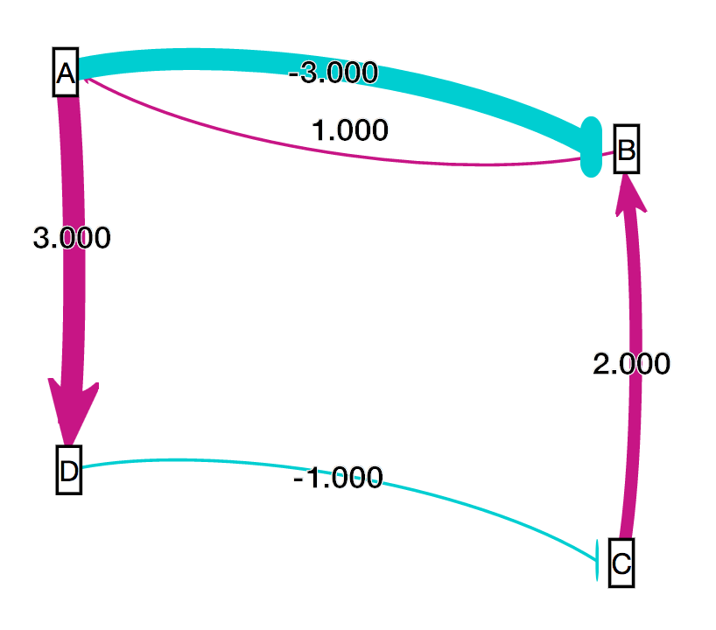
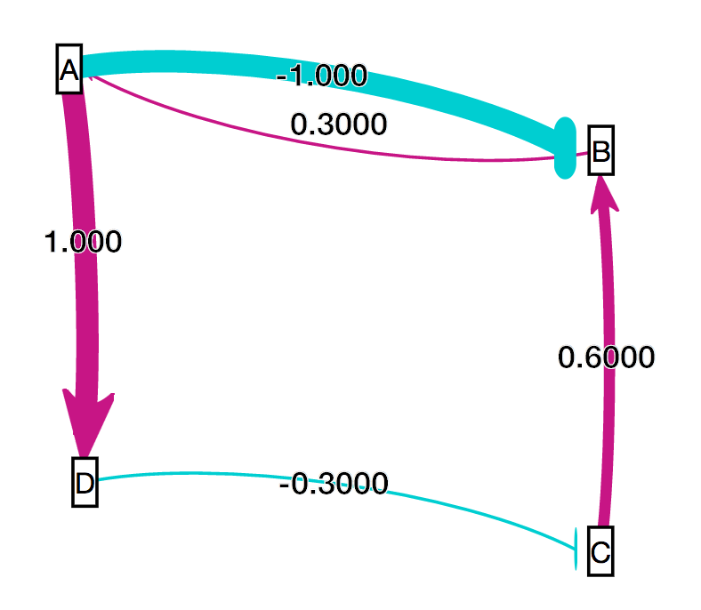
A Customizable Normalization Factor Allows Users to Compare Graphs
Relationship data is normalized to fit within 12 distinct edge thicknesses
Data from each graph is normalized according to matrix data
In order to compare graph visualizations, normalization factor must be the same
User inputs smallest value and largest value in all comparable matrices, and edge thicknesses adjust accordingly
Notes:
Anu
Add a graphic with a graph with one set of weights and another graphic with another set of weights and show the weights and show how they are not the same

Slide 17
The Drafting Board Was Enlarged for Optimal Graph Loading
The drafting board (drawable area) was initially too small to allow for the graph to fully expand to an optimal layout.
Larger viewport sizings allow for the graph to fully expand on load.
An automatic drafting board resizing algorithm is in development to allow graphs of all sizes to come to an optimal layout.
The drafting board will expand past the size of the viewport, and can be fully seen with zooming and scrolling.
The option of a hard (fixed to viewport) or adaptive (dynamic resizing) drafting board can be selected.
Notes:
nicole

Slide 18

Acknowledgments
Loyola Marymount University
Dr. Kam D. Dahlquist
Dr. John David N. Dionisio
Dr. Ben G. Fitzpatrick
GRNsight Team
Mihir Samdarshi
Jen Shin
Eileen Choe
Edward Bachoura
GRNmap Team
Trixie Anne Roque
Eddie Azinge
Natalie Williams
Kristen Horstmann
Maggie O’Neil
Brandon Klein
Justin Kyle Torres
Wet Lab Team
Monica Hong
Nika Vafadari
Katherine Scheker
http://dondi.github.io/GRNsight/
Insert Most Recent Photo Here
Notes:
Nicole
Show github icons and then click and show the picture, add all of our urls on the top of the page

